Slide 1
V4A CFO Training
Lunch & Learn with DARS
DARS Division for Community Living September 16, 2021

Slide 2
No Cost Extensions
All State Units on Aging have been provided a no-cost extension (NCE) from the Administration for Community Living (ACL) for the FFY 2020 Title III, Title VII, and NSIP grants as well as the FFCRA and CARES Act Title III and Title VII grants.
Notes:
Speaker Notes:

Slide 3
Project Period End Dates
Notes:
Speaker Notes:
So what that actually means is that the Project Period End dates that would have ended on 9/30/2021 have now been extended until 9/30/2022.

Slide 4
Use of Funding
Federal Funds
Because Families First & CARES Act funding is specifically appropriated for COVID-19 response, we encourage the use of federal funding in the following order:
Families First
CARES Act
“Regular” FY20 & FY21 Title III grant funds, starting first with the oldest funds available and utilizing the flexibility of the Major Disaster Declaration (MDD)
Supplemental Nutrition
Vaccine Access
10% Federal Carryover Limit waived going into FY2022
Notes:
Speaker Notes:
At the end of August, DARS was still showing funds remaining or expenditures needed in the following funding categories. This is a reminder to encourage the use of funding in the following order:

Slide 5
Use of Funding
State General Funds
Please note that carryover is not allowed for state general funds.
The Area Agency shall submit its final request for state general funds by June 12th. All such funds shall be obligated by June 30th of the Contract year and liquidated by September 30th of the reporting year, or the Area Agency shall return the unspent state general funds to the State Agency.
Notes:
Speaker Notes:

Slide 6
Use of Funding
The Families First, CARES Act, Supplemental Nutrition and Vaccine Access funding have all been issued under separate grant awards
Therefore, funds as well as service units and individuals served must be accounted for separately from the regular issuance of Title III OAA funding
Notes:
Speaker Notes:

Slide 7
Major Disaster Declaration (MDD)
Flexibility is provided for States – without the need for a separate application, transfer request, or request for a waiver -- to use existing allocations already made to them under Title III-B, C1, C2, D and E of the Act for disaster relief
Therefore, service units and individuals served are to be included in and accounted for within the total regular issuance of Title III OAA funding
Service units must be ‘flagged’ for Major Disaster Declaration in order to see how many of the total units were identified for MDD flexibility
Notes:
Speaker Notes:

Slide 8
Major Disaster Declaration (MDD)
Even though the COVID-19 state of emergency expired on June 30th, the MDD did not expire.
To assist with the Major Disaster Declaration, we have added a worksheet to the regular AMR entitled 'COVID-19'. This is where you will report all of your COVID-19 expenditures related to the funds that you want to use for any COVID-19 activities. This worksheet has the service columns listed with the funding sources that have been permitted open so that you can easily expend the funds as needed. This sheet is also where you will record the number of units and persons served for COVID-19 related expenses.
Notes:
Speaker Notes:

Slide 9
In Summary
Service units and individuals served using ‘Families First’ must be entered separately and reported separately from other units entry
Service units and individuals served using ‘CARES Act’ must be entered separately and reported separately from other units entry
Service units and individuals served using ‘Supplemental Nutrition’ must be entered separately and reported separately from other units entry
Service units and individuals served using ‘Vaccine Access’ must be entered separately and reported separately from other units entry
Service units and individuals served where the flexibility under the Major Disaster Declaration is utilized must be ‘flagged’ in order to see what portion of the grand total of service units was under the MDD flexibility
Notes:
Speaker Notes:
When coding units in PeerPlace, please remember that units and individuals served using Families First, CARES Act, Supplemental Nutrition or Vaccine Access must be entered and reported separately from other units entry.
Also service units and individuals served where the flexibility under the Major Disaster Declaration is utilized, must be “flagged” in order to see what portion of the grand total of service units was under the MDD flexibility.

Slide 10
Required Services
The following two services are required for the FY22 Area Plan Year and must be included in the FY22 budget.
Nutrition Education
Nutrition Counseling
Also, please ensure that there is funding in the budget for any OAA services that are being provided.
Notes:
Speaker Notes:
As a reminder, DARS wants to make sure that everyone understands that Nutrition Education and Nutrition Counseling are required services for the FY22 Area Plan Year and must be included in the budget.
Also, we want to remind everyone to please ensure that there is funding in the budget for any OAA services that are being provided.

Slide 11
American Rescue Plan (ARP)
Awards Funds:
Title III B, C1, C2, D, E
Title VII Ombudsman
Project Period:
October 1, 2021 thru September 30, 2024
Funds are to be used on any allowable OAA Activities
Notes:
Speaker Notes:
Hope to have contracts issued early October 2021.

Slide 12
ARP - Fiscal Flexibilities
Presidentially Approved Major Disaster Declaration for COVID-19 under the Stafford Act
MDD Fiscal Flexibilities are available to ARP Title III funding only
Funding obligated under the MDD flexibility is available until the obligation is liquidated or the obligation period ends
Notes:
Speaker Notes:

Slide 13
ARP – Match Requirements
The American Rescue Plan Act did not waive match requirements for services and administration; therefore, all Title III Older American Act match requirements are in effect for ARP grants.
Match for supportive services and nutrition services must equal or exceed 15%. DARS has already identified a source to cover this requirement.
Area Plan Administration match must equal or exceed 25%.
Notes:
Speaker Notes:

Slide 14
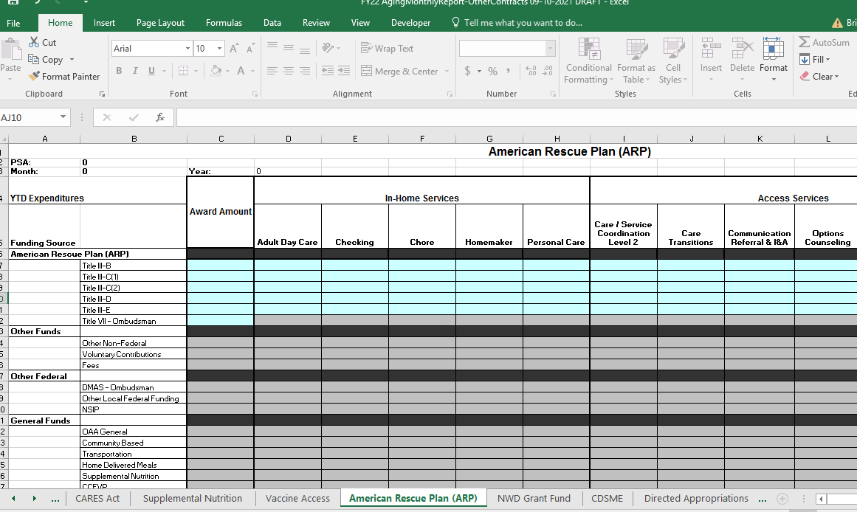
ARP - Reporting
Funds must be accounted for separately from the regular issuance of Title III Older Americans Act funding.
Enter the amount allocated to you on the AMR-OC and then enter your expenditures under the eligible services that are allowed.
Notes:
Speaker Notes:
The American Rescue Plan funds have been issued under a separate grant award number; therefore, funds must be accounted for separately from the regular issuance of Title III Older Americans Act funding.
An American Rescue Plan worksheet has been added to the AMR-OC form for you to request payment and track your expenditures, number of units and persons served. You will need to enter the amounts that your agency has been allocated under the Approved Budget column and then update your YTD expenditures each month under the services that were used with the number of units and clients served.
You will notice that Title VII-Ombudsman funding can only be used for the Ombudsman Program. The MDD flexibility is limited to the Title III funding.
Prep and Admin is allowed and is calculated at 10% of the grant with a 25% state match required.

Slide 15
ARP Data Entry
Similar to Families First , CARES Act and other additional awards, service units and individuals served using ‘ARP’ funding must be entered separately and reported separately from other units entry.
More information regarding Data Entry to follow as PeerPlace will need an enhancement to record and track program participants using the ARP funding.
Notes:
Speaker Notes:

Slide 16
Use of OAA Funding for Incentives
Area Agencies on Aging (AAAs) may use incentives to:
Promote awareness of programs and services within the community.
Increase participation in programs and services (e.g., congregate meals, physical activity classes, nutrition education workshops, caregiver support groups, and evidence-based disease prevention and health promotion programs).
Increase participation in research or evaluation projects that show the value of the AAA organization’s work.
Notes:
Speaker Notes:
Businesses, non-profit organizations, and research entities have long used incentives to raise awareness and encourage participation in their programs and services. Incentives such as gift cards, vouchers, giveaways, or prize items can motivate an individual to take action when they may not have otherwise. Within the aging network, incentives can be a useful tool. When used thoughtfully, they can increase the success of many programs.

Slide 17
How to Establish Incentive Program
Gift cards, gift items, giveaways, and prizes may be used in limited circumstances to meet the programmatic goals of the OAA. If an AAA chooses to allow and implement an incentive program:
All costs of the incentive program must meet Federal Cost Principles when purchased with OAA funds (i.e., costs are reasonable, allowable, and allocable).
The program must adhere to all Uniform Administrative Requirements, Cost Principles and Audit Requirements for HHS Awards found at 45 CFR 75 and other applicable federal laws and regulations.
State and local, policies, procedures, and requirements may be more restrictive than OAA and other federal laws, regulations and policies, and these state and local restrictions must be adhered to.
Consideration should be given to the purpose of the incentive, how it will be used effectively, sustainability, evaluation, and equity.
Notes:
Speaker Notes:

Slide 18
How to Establish Incentive Program
ACL recommends that AAAs consider the following seven elements in designing an incentive program:
Proposed Incentive
Justification
Anticipated gains
Defined amount
Qualifications for issuance
Method of issuance and tracking
Method of evaluation
Notes:
Speaker Notes:
ACL recommends that AAAs consider the following seven elements in designing an incentive program:
Proposed Incentive (i.e., what incentive will be provided?)
Justification (i.e., what is the purpose for the incentive and what is the specific reason for selecting this incentive? What evidence indicates that an incentive is needed, and what evidence suggests that the selected incentive will be effective at achieving the desired result?)
Anticipated gains (i.e., explain how providing such an incentive will defray societal costs or have a positive return on investment, for example by increasing overall participation. Additionally, describe potential unintended negative consequences and how those are outweighed by the benefits)
Defined amount (e.g., cost per person and total allocated funding for the recipient incentives)
Qualifications for issuance (i.e., what makes a person eligible for the incentive? Does it take into consideration issues related to equity in your community?)
Method of issuance and tracking [i.e., how will the incentive be delivered? Does the proposed plan and implementation align with any relevant policies and procedures governing your organization (e.g., procurement, ethics, etc.)? How will the budget and supply be tracked?]
Method of evaluation (i.e., how will the incentive plan be evaluated for effectiveness?)

Slide 19
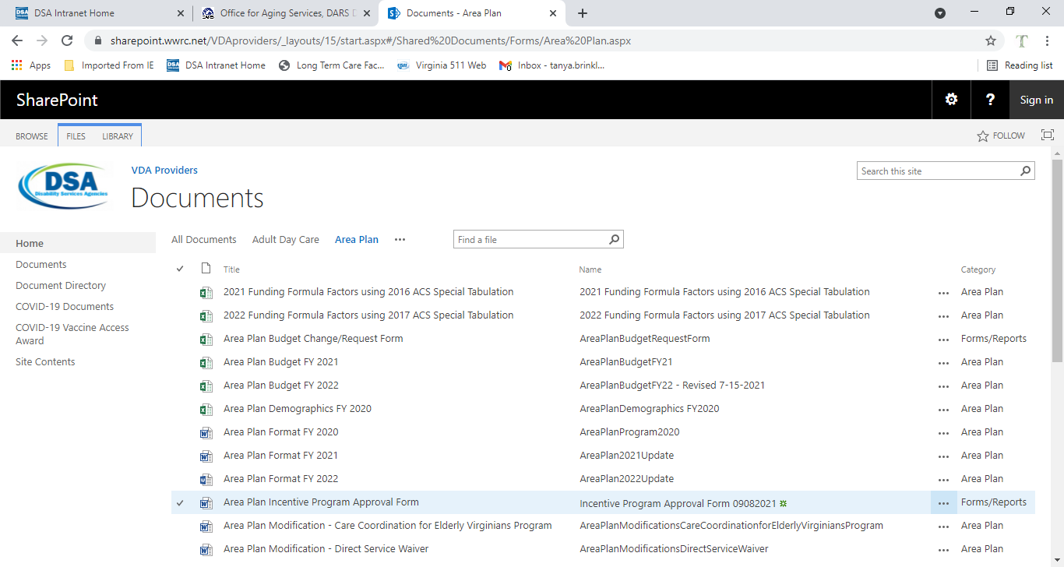
How to Establish Incentive Program
Any AAA that wishes to establish an Incentive Program will need to complete the newly created form that can be found on the Providers’ Portal and submit to Kathy Miller for approval before implementing the program.
Notes:
Speaker Notes:

Slide 20
OAA Funding Allowed for Approved Incentive Program
OAA Title III Regular Funding
Vaccine Access
American Rescue Plan (ARP) OAA Title III-B
Under the MDD, flexibility is given to include all ARP Title III grants.
Please note that further communications regarding the incentive program will be forthcoming. PeerPlace will need an enhancement to record and track program participants receiving the incentives and a revised AMR will be disseminated for billing purposes.
Notes:
Speaker Notes:

Slide 21
AMR & AMR-OC FY 2022
Updated AMR and AMR-OC spreadsheets are being created for the FY 2022 Area Plan Year. Please use the new forms when submitting your October expenditures.
These forms will be posted to the Providers’ Portal prior to October.
Notes:
Speaker Notes:

Slide 22
AMR-OC Expenditure Balances
When preparing your FY22 October AMR-OC, please use the expenditure balances that are shown remaining on the FFCRA ,CARES Act, Supplemental Nutrition, and Vaccine Access worksheet from the Final (13-month) AMR-OC after all FY21 YTD expenditures have been reported.
This will be the new starting expenditure balance from which all FY22 expenditures will be deducted. (This amount may be different than what is on your remit if you had requested any cash required for program operations in advance.)
Notes:
Speaker Notes:

Slide 23
AMR-OC Expenditure Balances
Notes:
Speaker Notes:
This is a visual that shows the CARES Act ending expenditure balances from the Final 13 Month AMR-OC. Notice how these balances are then entered as the starting expenditure balances on the October 2021 AMR-OC.

Slide 24
Question and Answer
Facilitated Group Discussion

